Slide 1

Winter 390 Presentation 1: Team 5
Fauzan Aryaputra, Paris Bozzuti, Ronaldo Tineo, Emma Smith, Aidan Balagtas
January 2026

Slide 2
Contents
Problem Statement
Python Scripts
Background & Current Method
Redundancies & Limitations
Code Organization Overview
Moving Forward
01
04
02
05
03
06

Slide 3
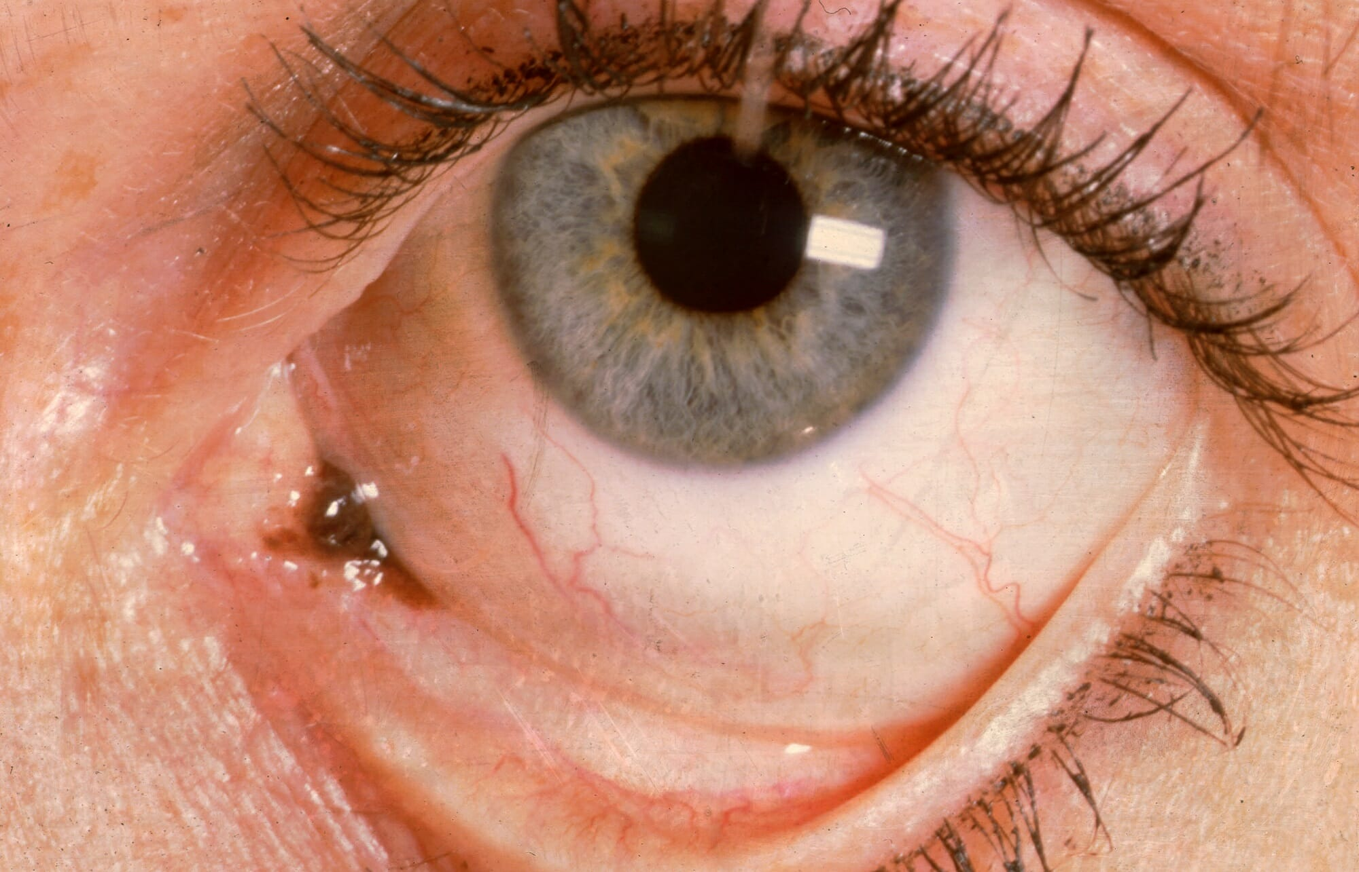
Problem Statement
Train a machine learning model to identify cancerous eye tissue, Conjunctival melanocytic intraepithelial lesions (C-MIL)
105 cases from 97 patients
Each case has 3 stains, each with its own strengths
Subjectivity in human identification
Only 39% of the responses were correct when 14 pathologists classified each of the 13 cases of Low-grade C-MIL
Risks of incorrect classifications
FP: Unnecessary follow-up or treatment (pain and expensive)
FN: Missed opportunity for early intervention, thus worse outcomes
Objective 1*
Objective 2*
“Develop a machine learning model to accurately classify Conjunctival melanocytic intraepithelial lesions (C-MIL) as per the WHO 2022 classification system”
“Provide a reproducible, and accurate grading of C-MIL so that the most appropriate management plan for the patient can be developed”
Machine Learning can improve the accuracy of human classification by reducing subjectivity
Notes:
Emma
As per the WHO 2022 classification of C-MIL:
Benign melanosis
Low-grade C-MIL
High-grade C-MIL
How does dependency on experts effect the model accuracy?
• There is human error in labelling
• Experts may not label all the cases the same way if they label again!
• Ground truth is typically not 100% accurate as it contains human errors
• However, a ML can be robust to human errors as long as the human errors are small (~10%
mislabelled data, recall the bias-variance tradeoff)
• Thus, the ML model is likely to be more accurate than humans as long as it captures all the
patterns that humans capture

Slide 4
Background & Current Method
Motivating Paper
Fall 2025 Methodology Overview & Results
Synergistic H&E and IHC image analysis by AI predicts cancer biomarkers and survival outcomes in colorectal and breast cancer
The motivating paper shows a transformer-based model that predicts the status of breast cancer by using biomarker evaluation. This model outperforms the current methods that are used to identify cancer patients who will respond to different treatments based on a clinical analysis of their cancer tissue. The model uses the images of the tumors to predict what biomarkers can be used to select patients for specific treatments. The model specifically predicts the status of biomarkers in the tissue.
The method outlined in the Fall 2025 cohort’s work covers training a 3 level hierarchical attention model, based off of a DenseNet121 model, pooling levels, and then the classifier at the end. The model training loop includes an Adam optimizer, cross-entropy loss, learning rate scheduling, and early stopping. Essentially, this combines the information from the three states to create the final prediction.
There are holes in the approach in terms of regularization, information overlap, and hyperparameter tuning.
Notes:
Paris
In order to understand the work done last quarter, I spent some time with the motivating paper and the work done by the Fall 2025 Cohort.
The motivating paper follows a research study done to see how using image analysis machine learning can help to predict biomarkers for breast cancer patients and identify treatment paths. While this is a different type of cancer, the model uses images of the stained slides of tumors, the same way ours will. By identifying the proper biomarkers with this model, medical professionals are able to better select treatment for these patients.
The reason this matters is that the process for this kind of decision making is typically human-led which opens up the possibility for human error. Creating an accurate model will improve the patient experience and provide an efficient evaluation.
The code written by the Fall25 cohort uses 3 different attention modules with uniform architecture, and a base model of DenseNet121.

Slide 5
Code Organization Overview
Data Loading
Data Preparation
Splitting & Final Dataset
Group patches by slice, map slices to class
(Data_utils.py)
Split data, transform patches, create PyTorch data loaders
(Dataset.py)
Load patches and labels
(Data_utils.py)
Model Generation
Training
Evaluation
Create MIL model using DenseNet121
(Model.py)
Handle tuning and training checkpoints
(Trainer.py)
Visualize results
(Trainer.py and visualization_predictions.ipynb)
Notes:
Aidan

Slide 6
Python Scripts
Objectives
01
02
03
04
main.py
config.py
utils.py
data_utils.py
- Main orchestration script to coordinate MIL pipeline
- Load data and split, create data loaders
- Initialize model and run training
- Evaluate on test set with optional attention analysis
- Central configuration file for defining hyperparameters, paths, and settings
- Set data locations, model settings, training parameters, data splits, and preprocessing settings
- Script holding miscellaneous utility functions for setup, and data preprocessing
- Set random seeds
- Format data summaries
- Create run directories, save/load data splits
- Check data integrity and monitors memory usage
- Data preprocessing utilities for MIL training
- Load labels, find patch files, group patches by case, slice, and stain
- Handle train/val/test splitting with stratification
- Validate no data leakage
- Generates summary statistics
Notes:
Aidan - PyTorch dataloader helps with batch loading and data shuffling for CNN (improve performance between epochs)
Data utils summary stats: for each case, get # of slices and patches per stain, how many are missing

Slide 7
Python Scripts (Cont.)
Objectives
05
06
07
08
dataset.py
model.py
trainer.py
attention_analysis.py
- Create a class for MIL training dataset
- Each case ID has dict of stains, each stain mapped to list of patches
- Includes helper functions for loading slices and transforming images
- Utility functions for MIL attention handling and densenet121 model setup
- Set up attention pooling mechanism and hierarchical attention handling
- Stain processing and attention calculation
- MIL model creation
- Create class for handling both training and evaluation
- Set up single-epoch training and full training loop
- Validation by average loss and accuracy
- Saving/loading checkpoints
- Evaluation on test set with accuracy, save predictions and confusion matrix
- Script for performing optional attention analysis
- Analyze attention at case/stain/slice/patch level
- Generate visualizations
Notes:
Aidan

Slide 8
Redundancies in Code
Code Analysis
In models.py, set base_model parameter to densenet121 in both initialization and create_model function (only need to do once)
In attention_analysis.py, the same denormalization method is applied 3 times, and it may be easier to use a helper function for this instead.
In trainer.py, dimension handling occurs 4 times without a helper function.

Slide 9




Problem Setup
Math
The model is trained under case-level supervision over 85 patients, while internally processing ~80k patches across three stains, motivating a hierarchical attention-based MIL architecture.
Problem Structure
Multiple Instance Learning (MIL)
Case
Motivation
Stains
3 Stains per case: H&E, Melan-A, Sox10
Slices
Multiple slices per stain: H&E has 3, Melan-A has 2, Sox10 has 1
MIL
Patches
Slices are divided into many patches
But we only observe case-level labels!

Slide 10
Data Preprocessing
Math (1)
Train / Test / Val Splits
Split | Cases | Case % | Benign | High- Grade |  | Patches | Patch % | Benign | High- Grade
Train | 50 | 59% | 17 | 33 |  | 47,679 | 60% | 15,639 | 32,040
Test | 17 | 20% | 6 | 12 |  | 15,631 | 20% | 5,968 | 9,663
Val | 18 | 21% | 5 | 12 |  | 16,166 | 20% | 4,130 | 12,036
Total | 85 | - | 28 | 57 |  | 79,476 | - | 25,737 | 53,739

Slide 11
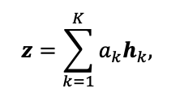
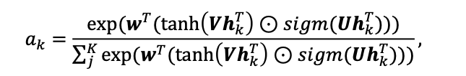
Hierarchical Attention
Math (2d)
Bag Embedding
Weight Calculation

Slide 12
Model Overview + Tensor Flow
Math (2a, 2d)
01
02
03
04
Initial Image Input
Batched Image Input
KimiaNet Output
Flatten
Single patch: raw image input cropped from a slice represented as coordinates of pixel intensities
Multiple patches are batched together to be processed simultaneously
Each batch is passed through a pre-trained KimiaNet to detect high-level features and adaptively pooled into a fixed 2x2 spatial grid with 1024-dimensional embeddings
Turn each pooled feature grid to a single vector
(C, H, W)
(B, M, C, H, W)
(1, M, 4096)
(1, M, 1024, 2, 2)
05
06
07
08
Patch Projector
Patch-Level Attention + Stack
Stain-Level Attention + Stack
Case-Level Attention
Maps the pooled features into patch embeddings that capture features relevant for melanoma detection
Learns which stains matter most and produces a single embedding representing the entire case
Learns which patches in a slice matter most and aggregates them into a single slice representation
Learns which slices are informative and aggregates them into one stain representation
(M, 512)
(1, 512)
(1, 512)
(1, 512)
09
Case Classifier
Maps the case embedding to class scores used for classification
(1, 2)

Slide 13

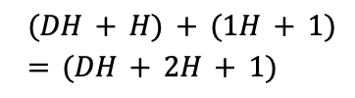



Trainable Parameters
Math (2b)
Let F = # KimiaNet Features (1024), D = Embedding Dimensions (512), H = Hidden Layer Size (128), C = # Classes (2)
01
02
03
04
Patch Projector
Attention Pool
Multiple Attention Pools
Final Classifier
Four 1024-dimensional identified features from KimiaNet are passed through the patch projector to get a 512-dimensional patch-level embedding
MLP that takes in 512-dimension embedding through one hidden layer of size 128 to output importance score
We perform this attention pooling three times when we run the model, so we train three sets of parameters of the attention pooling
Takes in the 512-dimension case level embedding and outputs probabilities for the two classes
= 2,097,664
= 197,379
= 1,026
= 2,296,069

Slide 14
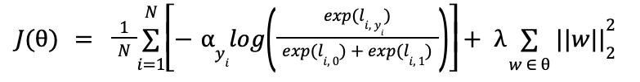
Loss Function
Math (2c, 2e)
Penalizes confident misclassification, emphasizes rare classes via weighting, and discourages overfitting via weight decay.
Weighted Cross-Entropy Loss
L2 Regularization
Training Details:
Optimizer: Adam
Alphas | Benign: 2.5, High-Grade: 1
Lambda: 2e-4

Slide 15



Training / Optimization + Prediction
Math (2e)
Training
Prediction
Forward Pass - Obtain Logits
Backward Pass - Update Weights
Gradients flow through attention, projector
Stops at frozen KimiaNet/DenseNet
Disable dropout during prediction

Slide 16
Limitations in Code
Code Analysis
Attention Pooling Method
Scikit Learn Hyperparameter Tuning
The current method gives each patch only one importance score, so the method is limited in terms of capturing more complex patterns and context from other patches nearby. Replacing it with a more complex method may allow for more deep analysis.
This hyperparameter tuning works, but is relatively simple. We could modify main.py with a different hyperparameter tuning function to improve performance. This would make it easier to evaluate each approach we try, and decrease the amount of training time needed to find good hyperparameters.
Notes:
Paris (Limitations)
Read attention pooling thing
For instance, if we use a Multi-head approach instead, we could be able to learn different aspects of the slices, like the stroma and inflammatory cells, and be able to combine multiple patterns rather than a single one. This would create a deeper learning that may be better than what the model currently uses.
The group suggested that using Optuna may be beneficial, and after some research it seems like it could help with using CV in each trial, and create a far more efficient approach.

Slide 17
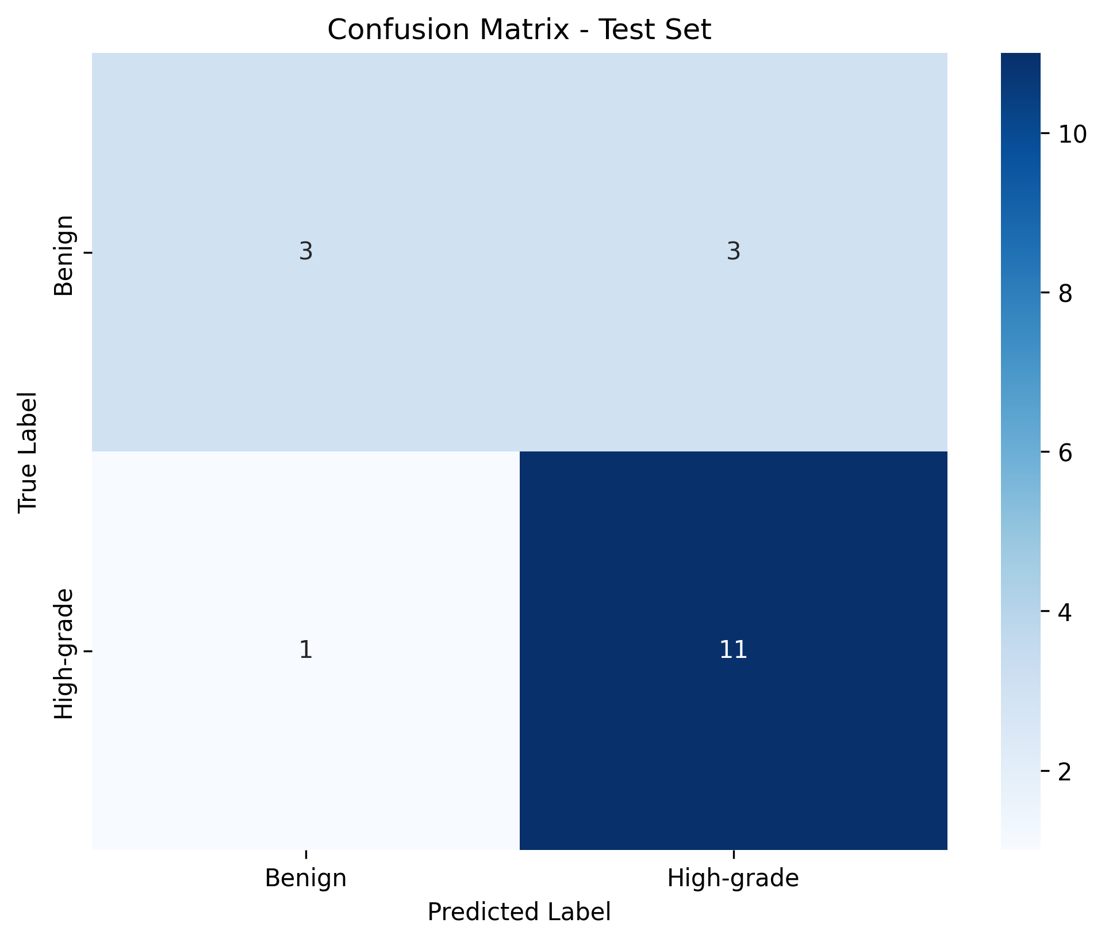
Model Classification Performance
Most high-grade cases are correctly identified
11/12 high-grade cases were predicted correctly
Some benign cases are flagged for further review
Model prioritizes catching serious disease
Notes:
This confusion matrix shows how the model performs at the case level. The key takeaway is that the model correctly identifies nearly all high-grade cases — it gets 11 out of 12 right — which is evidently important given the context of our topic of research, where missing a high-grade lesion can be detrimental to the research and potential patients.
We also do see a few benign cases being flagged as high-grade. However, in practice this would mean additional review rather than incorrect treatment. From a safety perspective, this is a more acceptable error than missing aggressive disease.
Overall, the model is intentionally conservative. It’s designed to support pathologists by highlighting potentially high-risk cases, rather than making final diagnostic decisions.

Slide 18
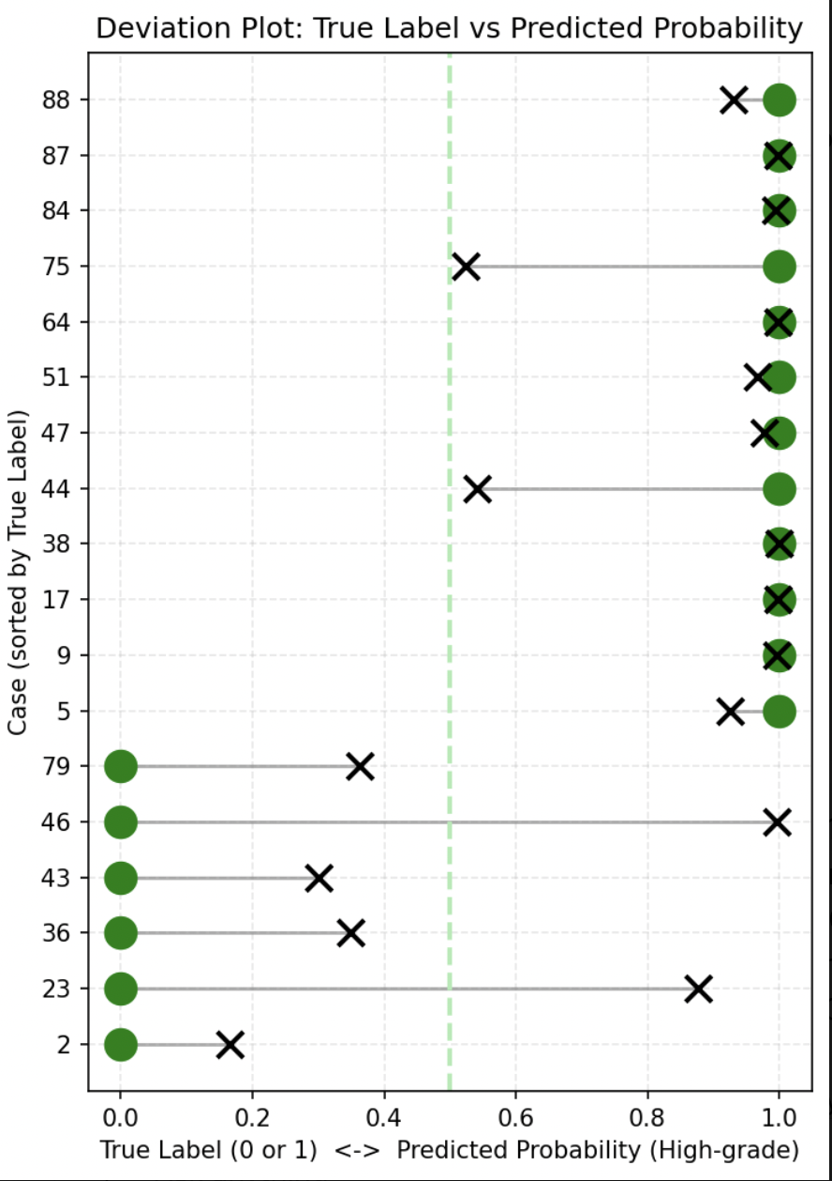
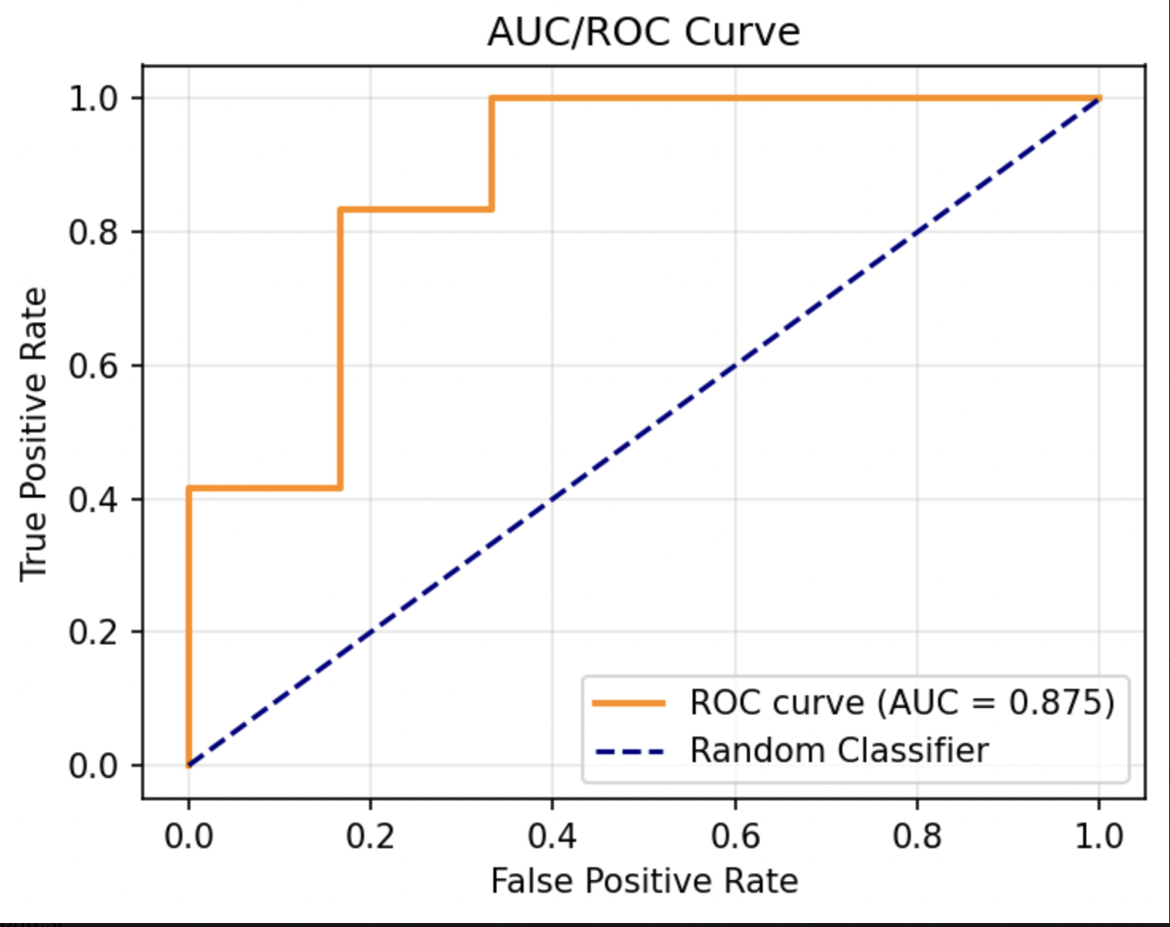
Model Confidence and Class Separation
Most high-grade cases receive high predicted scores
Errors happen near the decision boundary
Model consistently ranks high-grade cases above benign ones
Notes:
These two plots help us understand not just whether the model is correct, but how confident it is in its predictions. On the left, we see the predicted score for each case. Most high-grade cases are predicted with high confidence, while benign cases tend to fall on the lower end.
The few mistakes the model makes tend to occur close to the cutoff, where cases are ambiguous. This mirrors real clinical uncertainty rather than random error.
On the right, the curve shows that across many possible cutoffs, the model consistently separates high-grade cases from benign ones. This tells us the model has real signal and that its performance isn’t dependent on one arbitrary threshold.
Since we better understand how these models are performing from these visualization, we can also use them to inform where we should improve. For example, since we know from the confusion matrix that the model over flags benign cases, we know we should work on reducing false positives rather than increasing sesntitivity. Or, the deviation plot tells us that the model could benefit from things such as improved patch selection to reduce ambiguity.

Slide 19
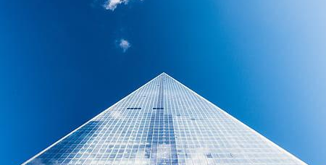
Moving forward
01
Ideas
01
02
03
Matching slices
May reduce cases available if there are not matches
Model can cross reference stains, possibly improving accuracy
Regularization
Identify ways to directly affect attention distribution in order to prevent the distribution from being sparse
Patch Selection
Currently if there are >500 patches in a case, 500 are randomly selected
Develop a methodology for strategic selection
Notes:
Emma

